Slide 1
MSc Artificial Intelligence
Knowledge Engineering
Week 1: Logic in AI
Notes:
This colour bar is to be used for Artificial Intelligence

Slide 2
Logical Reasoning
Einstein’s Riddle
There are five houses.
The Englishman lives in the red house.
The Spaniard owns the dog.
Coffee is drunk in the green house.
The Ukrainian drinks tea.
The green house is immediately to the right of the ivory house.
The Old Gold smoker owns snails.
Kools are smoked in the yellow house.
Milk is drunk in the middle house.
The Norwegian lives in the first house.
The man who smokes Chesterfields lives in the house next to the man with the fox.
Kools are smoked in the house next to the house where the horse is kept.
The Lucky Strike smoker drinks orange juice.
The Japanese smokes Parliaments.
The Norwegian lives next to the blue house.
Who drinks water?
Who owns the zebra?
5 | 3 |  |  | 7
6 |  |  | 1 | 9 | 5
 | 9 | 8 |  |  |  |  | 6
8 |  |  |  | 6 |  |  |  | 3
4 |  |  | 8 |  | 3 |  |  | 1
7 |  |  |  | 2 |  |  |  | 6
 | 6 |  |  |  | ? | 2 | 8
 |  |  | 4 | 1 | 9 |  |  | 5
 |  |  |  | 8 |  |  | 7 | 9

Slide 3
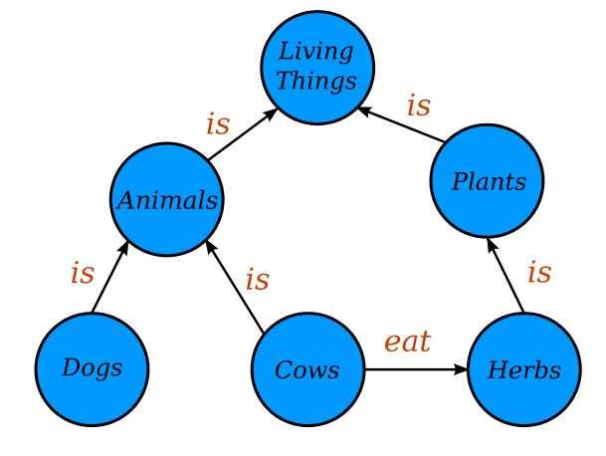
Graphical Representations of Knowledge
https://commons.wikimedia.org/wiki/File:Conceptual_Diagram_-_Example.svg
Original image by Jayarintha, licensed under the Creative Commons Attribution-Share Alike 4.0 International license.

Slide 4

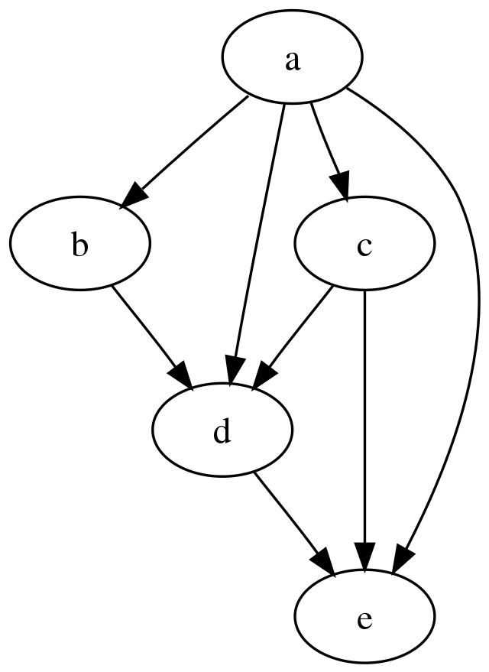
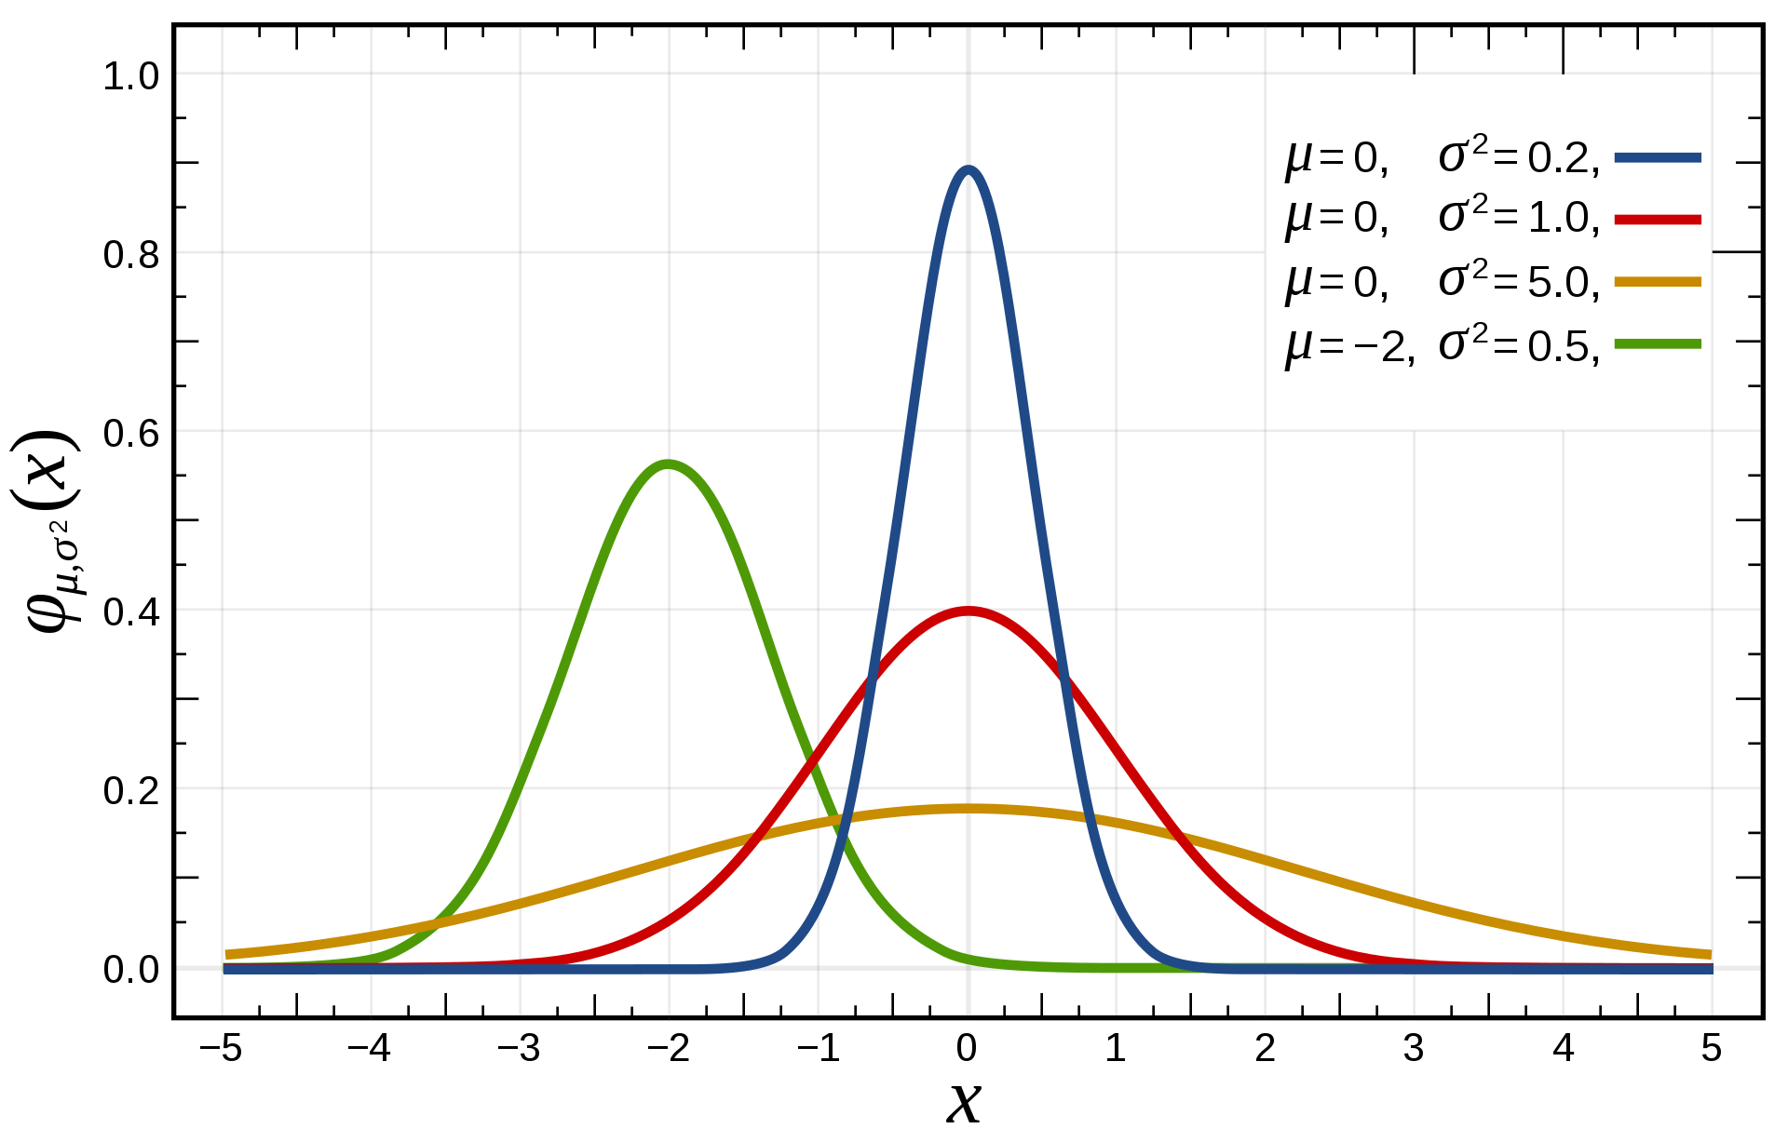
Causal Reasoning
If it is raining I carry an umbrella
It isn’t raining
Therefore …
It is raining.
Everyone is carrying an umbrella.
Therefore, umbrellas cause rain.

Slide 5
Learning Outcomes
Successful students will be able to:
Gain a systematic understanding of knowledge, principles and procedures of knowledge engineering
Demonstrate a critical awareness and evaluation of current and complex issues and developments in knowledge engineering
Demonstrate critical understanding of research techniques in knowledge engineering and ability to critically evaluate them
Demonstrate innovative application of the knowledge, principles and procedures of knowledge engineering in making sound judgements and proposing new hypotheses

Slide 6
Outline Syllabus
Logic
Propositional logic
First order logic
Natural Deduction
Automated Reasoning
Knowledge and knowledge representation
Knowledge Bases
Knowledge Graphs
Large Language Models
Reasoning under Uncertainty
Probabilities, conditional independence;
Bayesian networks
Causal Reasoning (if time)

Slide 7
How the Course will be Taught
Lectures will be kept short-ish and single topic
There are extensive written notes on canvas. You need to read these.
Lots of problems to work though – some paper-based
Plenty of live coding

Slide 8
Assessment
Two-part assessment:
Part 1 due Monday 27 October at 0900, worth 30%
Feedback by Monday 10 November in time for…
Part 2 due Monday 8 December at 0900, worth 70%
Both parts released at 0900 on Monday 29 September

Slide 9
Timetable
Weeks 1-3 are different because of room availability issues
Week 1: 1000–1300 and 1400–1700 in CSB/0G/028
Weeks 2 & 3
0930 – 1300 in CSB/01/020
1400 – 1500 in CSB/0G/028
Week 4 onwards: 1000–1300 and 1400–1700 in new lecture room in David Keir Building

Slide 10
Can you solve them?
Einstein’s Riddle
There are five houses.
The Englishman lives in the red house.
The Spaniard owns the dog.
Coffee is drunk in the green house.
The Ukrainian drinks tea.
The green house is immediately to the right of the ivory house.
The Old Gold smoker owns snails.
Kools are smoked in the yellow house.
Milk is drunk in the middle house.
The Norwegian lives in the first house.
The man who smokes Chesterfields lives in the house next to the man with the fox.
Kools are smoked in the house next to the house where the horse is kept.
The Lucky Strike smoker drinks orange juice.
The Japanese smokes Parliaments.
The Norwegian lives next to the blue house.
Who drinks water?
Who owns the zebra?
5 | 3 |  |  | 7
6 |  |  | 1 | 9 | 5
 | 9 | 8 |  |  |  |  | 6
8 |  |  |  | 6 |  |  |  | 3
4 |  |  | 8 |  | 3 |  |  | 1
7 |  |  |  | 2 |  |  |  | 6
 | 6 |  |  |  | ? | 2 | 8
 |  |  | 4 | 1 | 9 |  |  | 5
 |  |  |  | 8 |  |  | 7 | 9

Slide 11
What reasoning abilities did you use?
Do these tasks require intelligence?
What do they have in common?
Knowledge acquired incrementally
When new knowledge is discovered, have to revisit old knowledge to draw conclusions
Can we write computer programs to solve them?
Can we write one computer program that will solve them all?
Why are games like these relevant to real-world problems?

Slide 12
Logic vs Data
Why, in an era of big data, do we need to study logic?
Are models learned from data always correct?
What if we need provably correct results?
True intelligence needs to be able to reason rigourously.
LLMs are getting better at this quickly, but no guarantees

Slide 13
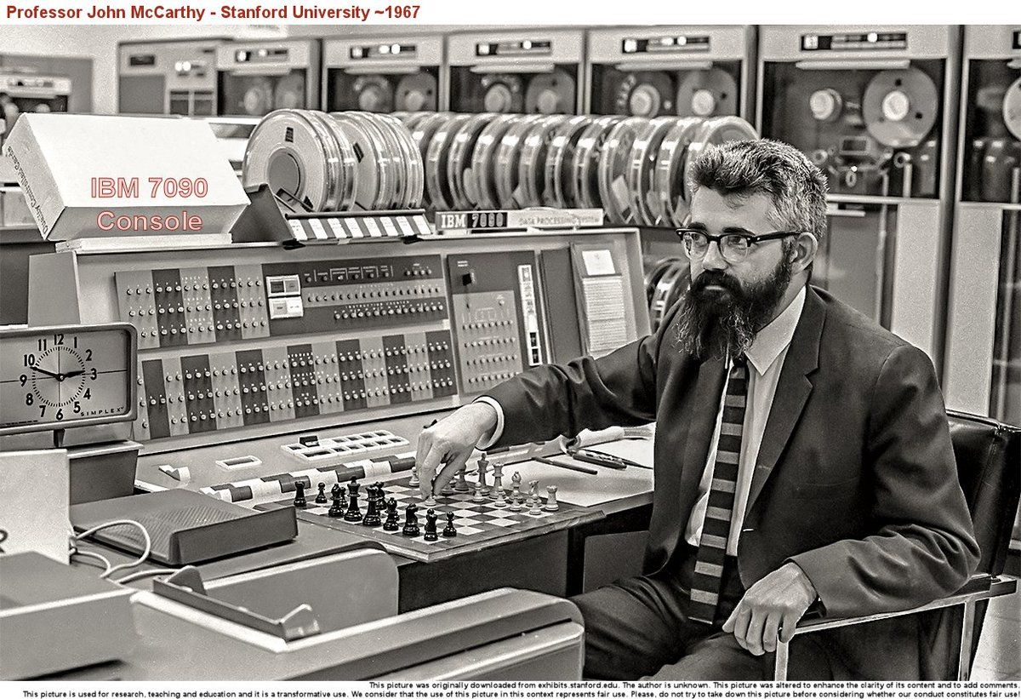
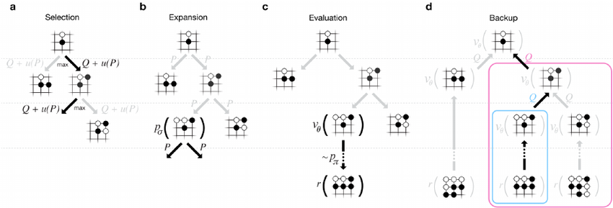
Symbol Manipulation and Intelligence
Early AI researchers regarded reasoning as central to intelligence
Minsky, McCarthy et al placed great emphasis on symbol manipulation
Expert systems were very popular in the 1970s
Why?
And why did symbolic AI "fail"?
Lots of current effort to get ML systems to do symbol manipulation
AlphaGo, AlphaFold both include elements of symbolic reasoning

Slide 14
Logic and Intelligence
“If intelligence requires reasoning
And logic is the study of reasoning
Then…?”
A more cliched example:
Socrates is a man
All men are mortal
…
A deductive truth.
Should AI systems be able to do this?

Slide 15
MSc Artificial Intelligence
Knowledge Engineering
15 September 2025
Notes:
This colour bar is to be used for Artificial Intelligence

Slide 16
Exercise 1: Are you Logical?

Slide 17
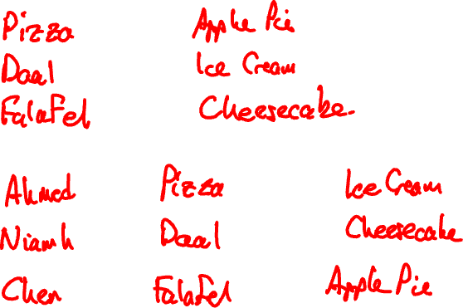

Slide 18
Propositional Logic
Humans know facts
- It is colder in the winter than in the summer.
- Mount Everest is the tallest mountain in the world.
- Water makes you wet.
Facts are grounded: we know what a mountain is
How do these facts differ from data?

Slide 19
Propositional Logic
Humans can reason over facts
We can make decisions and draw conclusions
Can we get computers to do the same?
Computers require a formal language: Logic
Logic – the study of correct reasoning- will allow us to formally represent facts and reason about them
Propositional Logic is a simple form of logic that allows us to do just this

Slide 20
Propositions
A proposition is a statement that can be True or False
It is colder in the winter than in the summer.
Mount Everest is the tallest mountain in the world.
Water makes you wet.
A Premise is a stated proposition and is like an axiom
A Conclusion is derived purely from the premise
Socrates is a man [Premise]
All men are mortal [Premise]
Therefore, Socrates is mortal [Conclusion]

Slide 21
Connectives
“Water makes you wet” is an atomic proposition
We can connect these together to get new compound propositions
The car is blue and fuelled by petrol (The car is blue and the car is fuelled by petrol)
Books have hard or soft covers (Books have hard covers or books have soft covers)
If the sun is shining then it is daytime (If the sun is shining then it is daytime)

Slide 22
Correctness
If we use correct reasoning, if the premises of an argument are true then its conclusion must be True
Socrates is a man
All men are mortal
Therefore Socrates is mortal
Is our reasoning correct:
Some apples are red
All apples are tasty
Therefore, all red apples are tasty

Slide 23

Validity and Soundness
Is our reasoning correct:
Some apples are red
Some apples are tasty
Therefore, some red apples are tasty
This is an INVALID argument
Is our reasoning correct:
All apples are red
Some apples are tasty
Therefore, some red apples are tasty
This is VALID but is not SOUND
CORRECT DEDUCTIVE REASONING MUST BE BOTH VALID AND SOUND

Slide 24
Exercise 2: Elementary, my dear Watson

Slide 25
Formal Propositional Logic
Humans are excellent at reasoning using natural language, but machines are not.
To automate deductive reasoning, we need to reduce it to symbol manipulation
One symbol to represent each atomic proposition
Each symbol can be True or False

Slide 26
Making Logical Arguments Formal
If it is not raining and I am going outdoors then I do not take a coat or an umbrella.
What are the atomic propositions?
R: It is raining
O: I am going outdoors
C: I will take a coat
U: I will take an umbrella
Each can be True or False

Slide 27
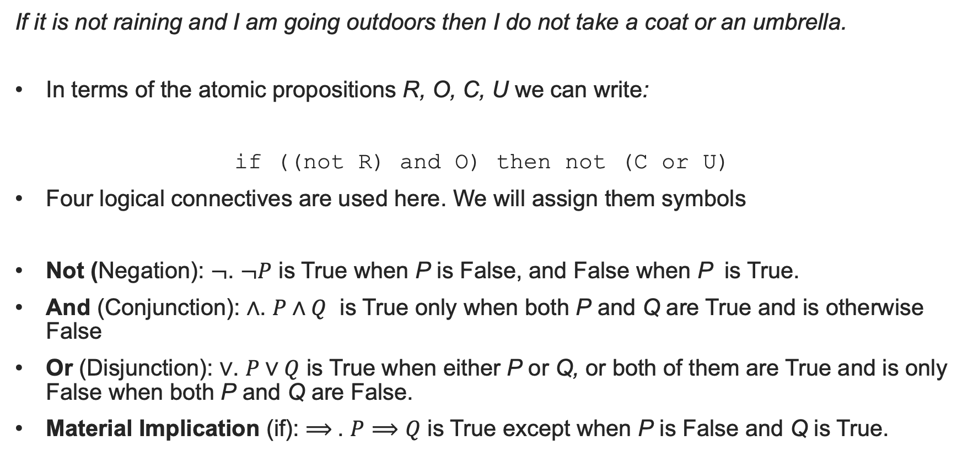
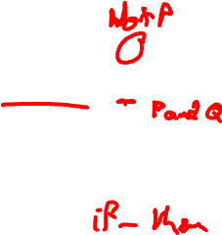
Logical Connectives
If it is not raining and I am going outdoors then I do not take a coat or an umbrella.
In terms of the atomic propositions R, O, C, U we can write:
if ((not R) and O) then not (C or U)
Four logical connectives are used here. We will assign them symbols
Not (Negation): $¬$. $¬P$ is True when P is False, and False when P is True.
And (Conjunction): $∧$. $P∧Q$ is True only when both P and Q are True and is otherwise False
Or (Disjunction): $∨$. $P∨Q$ is True when either P or Q, or both of them are True and is only False when both P and Q are False.
Material Implication (if): $⟹$. $P⟹Q$ is True except when P is False and Q is True.

Slide 28
Truth Tables
The effect of Logical connectives is best illustrated by their Truth Tables
A Truth table tells us whether a Compound proposition is True or False depending on the Truth of the compound propositions
Is the statement “if it is cold I wear a hat” True or False if the statements “I am wearing a hat” and “it is not cold” are both true?
Understanding these will help us to model our knowledge using propositions

Slide 29
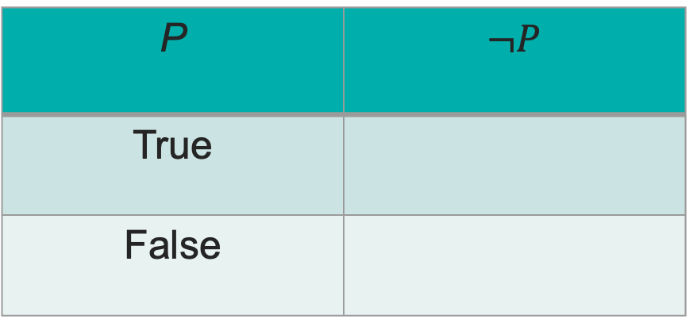
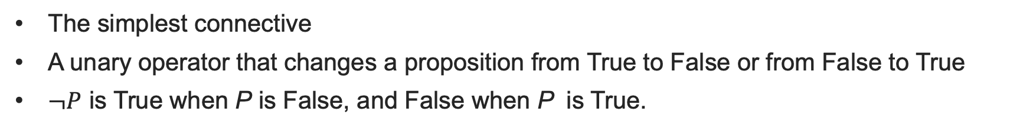

Negation (Not)
The simplest connective
A unary operator that changes a proposition from True to False or from False to True
$¬P$ is True when P is False, and False when P is True.
P | $¬P$
True
False

Slide 30
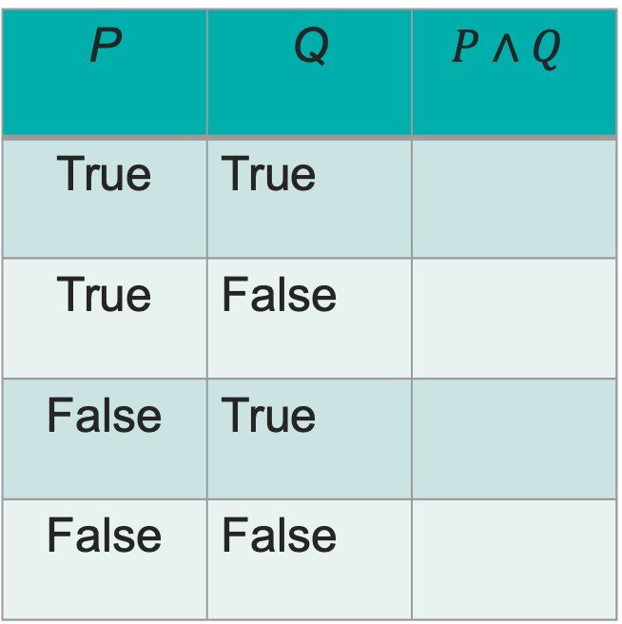
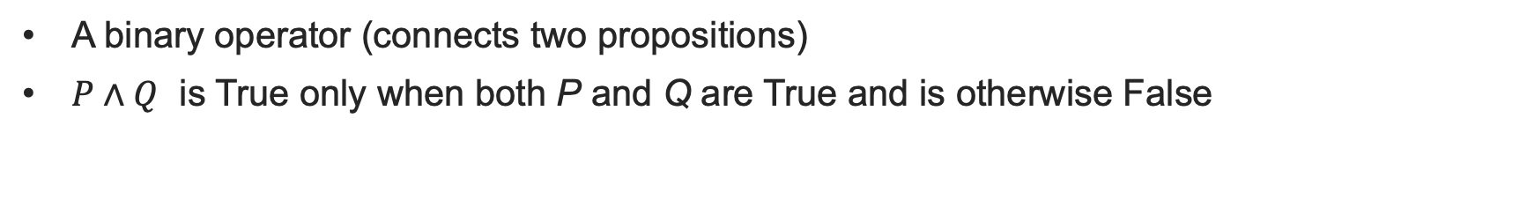

Conjunction (And)
A binary operator (connects two propositions)
$P∧Q$ is True only when both P and Q are True and is otherwise False
P | Q | $$P∧Q$$
True | True
True | False
False | True
False | False

Slide 31

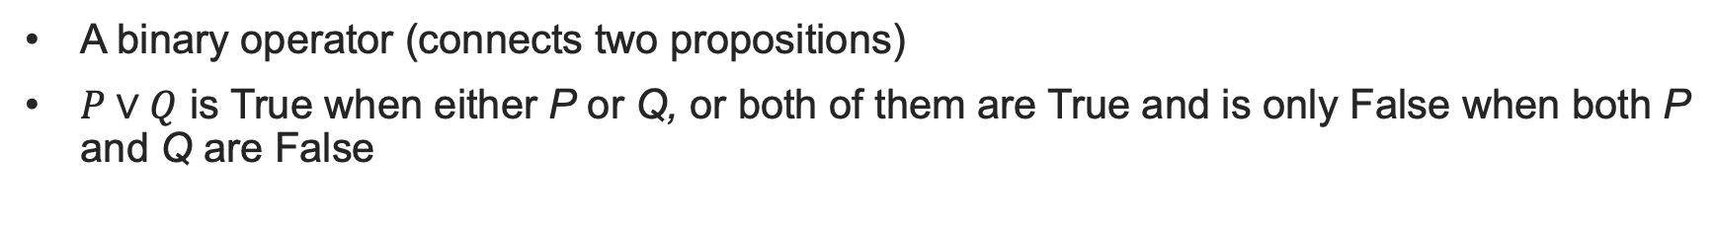

Disjunction (Or)
A binary operator (connects two propositions)
$P∨Q$ is True when either P or Q, or both of them are True and is only False when both P and Q are False
P | Q | $$P∨Q$$
True | True
True | False
False | True
False | False

Slide 32




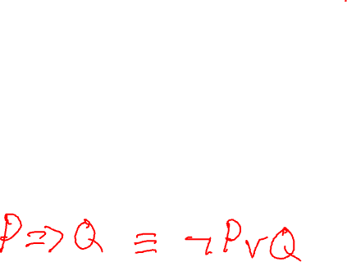
Material Implication
P | Q | $$P⟹Q$$
True | True
True | False
False | True
False | False
More subtle
$P⟹Q$ is read as “if P then Q”.
Not the same as if..then in programming
No native Python operator.
Can you write a lambda function implies(P,Q)?

Slide 33
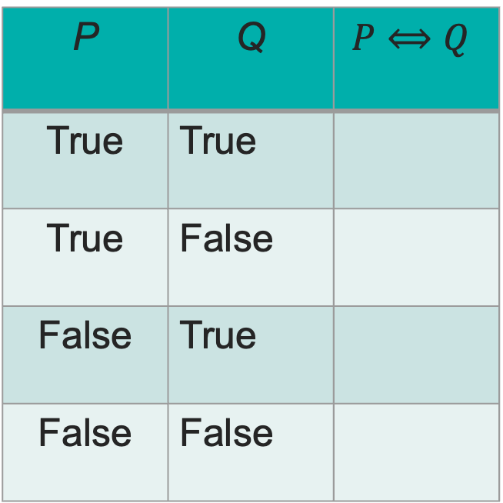
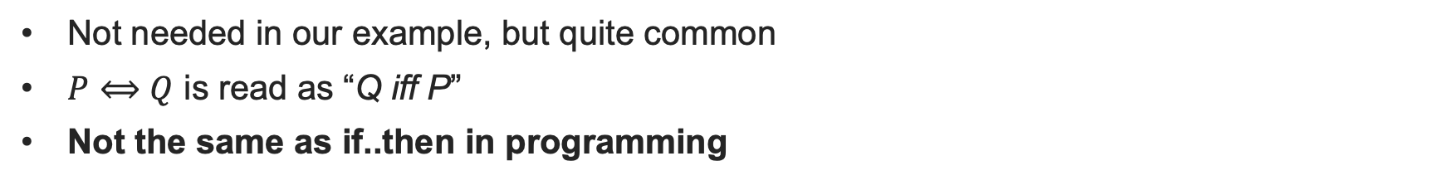
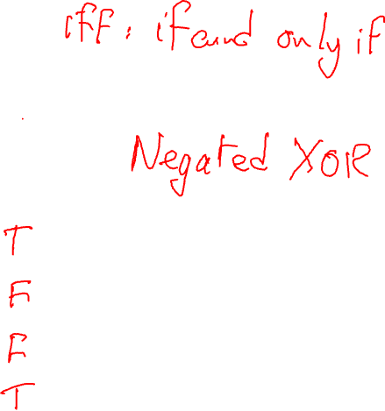
Biconditional
Not needed in our example, but quite common
$P⟺Q$ is read as “Q iff P”
Not the same as if..then in programming
P | Q | $$P⟺Q$$
True | True
True | False
False | True
False | False

Slide 34
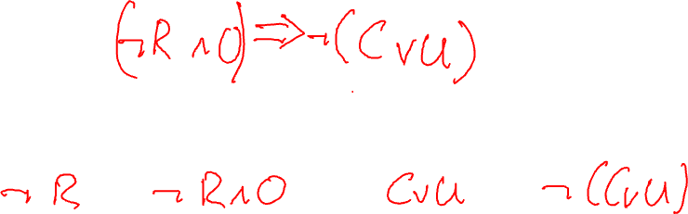
Back to our example
If it is not raining and I am going outdoors then I do not take a coat or an umbrella.
if ((not R) and O) then not (C or U)
Exercise: Can you compute the Truth Table for this?

Slide 35
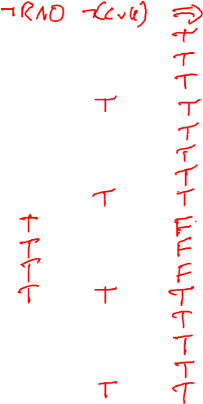
R | O | C | U
T | T | T | T
T | T | T | F
T | T | F | T
T | T | F | F
T | F | T | T
T | F | T | F
T | F | F | T
T | F | F | F
F | T | T | T
F | T | T | F
F | T | F | T
F | T | F | F
F | F | T | T
F | F | T | F
F | F | F | T
F | F | F | F

Slide 36
Exercise 3: Formal Dinners

Slide 37
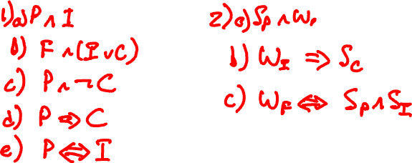

Slide 38
MSc Artificial Intelligence
Knowledge Engineering
15 November 2023
Notes:
This colour bar is to be used for Artificial Intelligence

Slide 39
Knowledge Bases
We have now studied enough knowledge to build a knowledge base.
What exactly do we mean by this?
We introduce the concept of an intelligent agent
The agent lives in some abstract world
A chess board
A Roomba
A medical database
The agent has a goal that it must achieve.

Slide 40
How can agents achieve their goals?
Examples of agent goals:
Capture the opponent’s King
Vacuum the entire floor area
Find a combination of medicines for a set of symptoms
The agent must be able to
Observe its environment
The opponent’s King is on square E8
The cat’s bed is in the corner by the heater
Medicines X addresses disease Y
Ask question about its environment to determine new knowledge
If I move my knight to A6, what could happen?
Medicines A and B address diseases X and Y but should not be taken together
Reason over the knowledge to ask a set of questions that enable decisions to be taken that achieve the goal

Slide 41
Knowledge Bases
A knowledge base records what the agent knows as a set of propositions
It may contain some prior information (premises)
It is written in formal notation to enable computation
The agent can update it as it discovers new things about the world
The agent aims to find one or more models that make the knowledge base True

Slide 42
A Familiar Riddle
Ahmed, Niamh, and Xin are three friends. They went for dinner together. Each of them ordered a main course (stew, daal, falafel) and a dessert (ice cream, apple pie, cheesecake. They each ordered a different main course and a different dessert. Use the following information to deduce who ordered what:
1. The person who ordered the stew did not order the apple pie
2. Niamh ordered the Dhal
3. Ahmed ordered the ice cream or the apple pie
4. Xin did not order either the ice cream or the cheesecake
5. The person who ordered the ice cream did not order the falafel
Can you formalize this?

Slide 43
MSc Artificial Intelligence
Knowledge Engineering
15 November 2023
Notes:
This colour bar is to be used for Artificial Intelligence

Slide 44
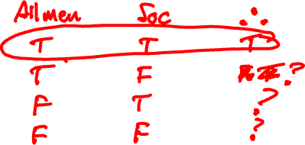
Proofs in Logic
All men are mortal
Socrates is a man
Therefore Socrates is mortal
We claim that this is sound and valid argument, but how do we know this?
Soundness is a matter of the truth of the propositions
Validity is whether the reasoning is correct
How can we unambiguously determine the validity of an argument?

Slide 45
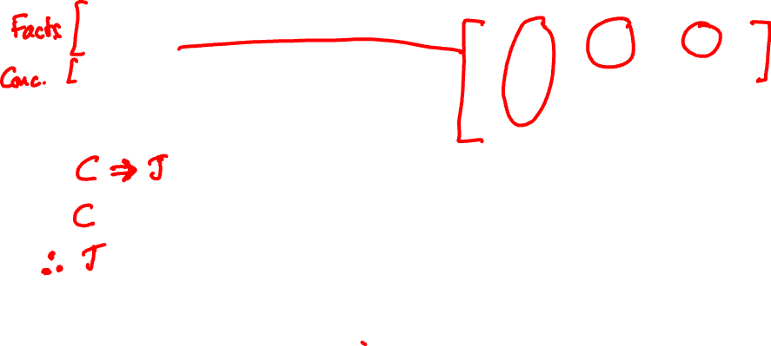
Truth Tables
C | J | C=>J
T | T | T
T | F | F
F | T | T
F | F | T
If it is cold, I wear a jacket
It is cold
Therefore, I wear a jacket
In symbols:

Slide 46
Model Checking
Each line of the truth table is called a model
All arguments can be rigourously checked by enumerating all possible models
An argument is valid iff there is at least one model for which all of the premises are True and the conclusion is True
This is known as model checking
The gold standard, but nearly always impractical

Slide 47
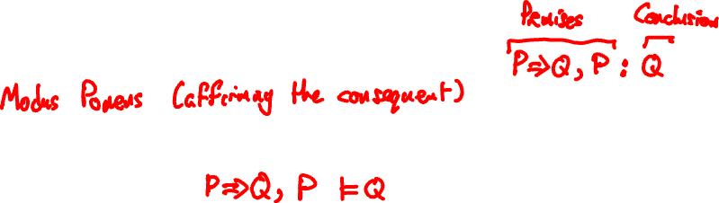
Model Checking
One way around the combinatorial explosion problem is to identify common parts of an argument, model check those, and then use them as part of a larger argument
Consider our earlier argument (written in sequent form):
We have verified this by truth table and can therefore take it as proven as rigorously as possible (semantically correct). We denote this as:
This is known as modus ponens (method of affirming) and is widely used as the basis for automated reasoning.

Slide 48
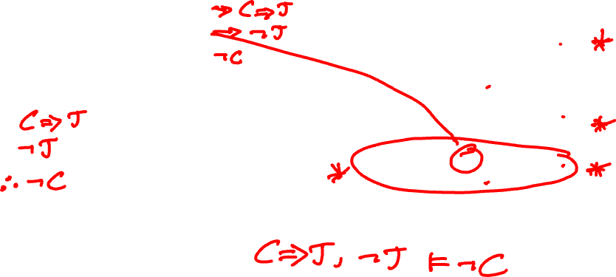
Truth Tables
C | J | C=>J
T | T | T
T | F | F
F | T | T
F | F | T
If it is cold, I wear a jacket
I am not wearing a jacket
Therefore, it is not cold
In symbols:
Modus Tollens (method of removing by taking away)

Slide 49
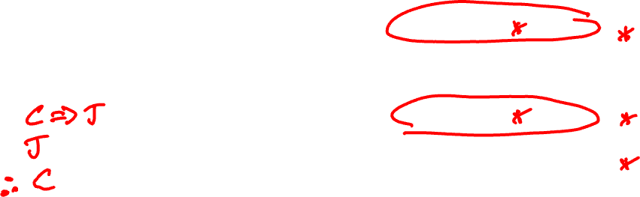
Truth Tables
C | J | C=>J
T | T | T
T | F | F
F | T | T
F | F | T
If it is cold, I wear a jacket
I am wearing a jacket
Therefore, it is cold
In symbols:
Affirming the consequent, or fallacy of the converse

Slide 50
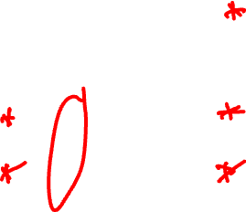
Truth Tables
C | J | C=>J
T | T | T
T | F | F
F | T | T
F | F | T
If it is cold, I wear a jacket
It is not cold
Therefore, I am not wearing a jacket
In symbols:
Denying the antecedent or fallacy of the inverse

Slide 51
Natural Deduction
Truth tables are impractical for larger problems
15 variables – 2¹⁵ = 32,768 models is feasible
50 variables is challenging!
We could simplify by exploiting constraints and check only models that we cannot immediately rule out
Not always obvious…
Can we instead formalize deductive reasoning?

Slide 52
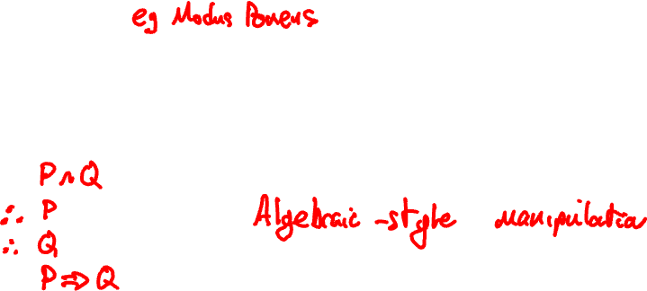
Natural Deduction
Model checking can be used to determine inference rules
These can be used to construct an argument to prove or disprove a proposition
Simple example: if P^Q is True, is P=> Q True?

Slide 53


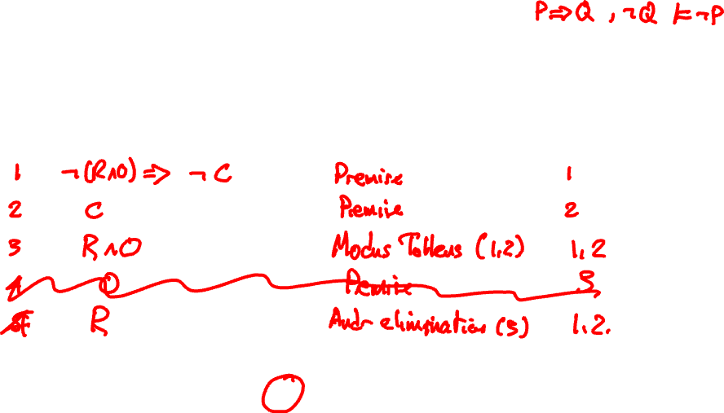
Example of a Formal Proof
Step |  | Inference Rule | Premises used

Slide 54
Common Inference Rules
P | Q
T | T
T | F
F | T
F | F

Slide 55
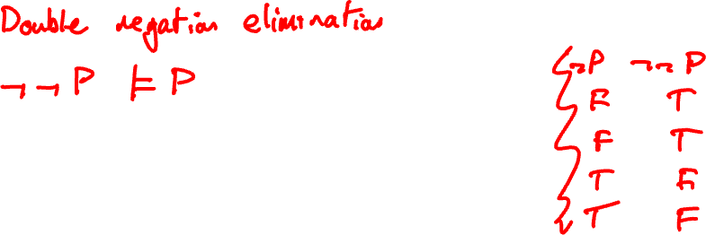
Common Inference Rules
P | Q
T | T
T | F
F | T
F | F

Slide 56
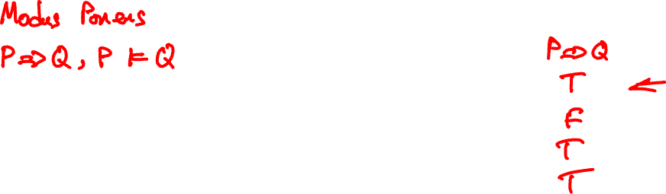
Common Inference Rules
P | Q
T | T
T | F
F | T
F | F

Slide 57
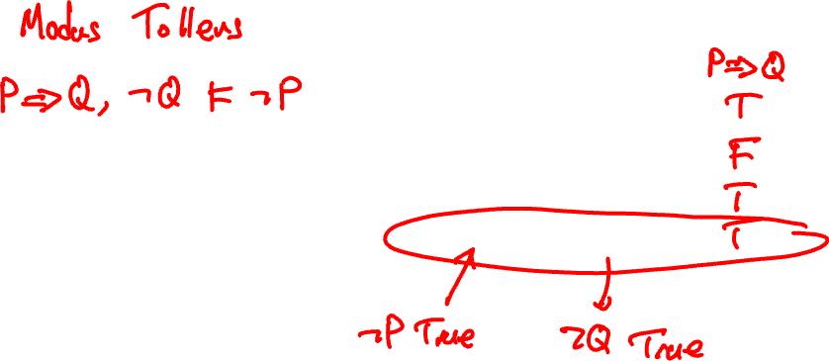
Common Inference Rules
P | Q
T | T
T | F
F | T
F | F

Slide 58
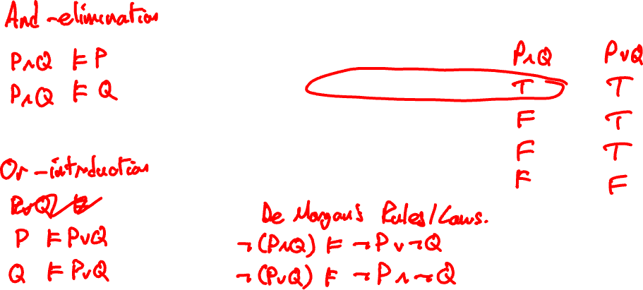
Common Inference Rules
P | Q
T | T
T | F
F | T
F | F

Slide 59
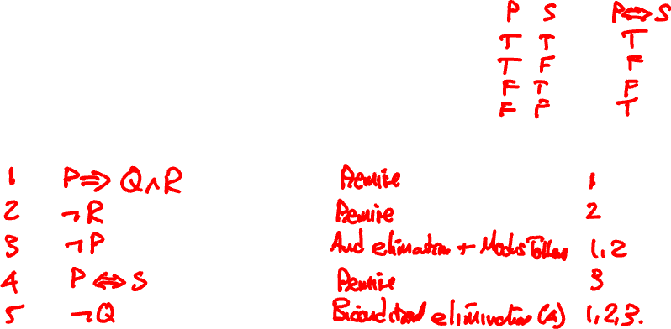
A more complex Proof
Step |  | Inference Rule | Premises used

Slide 60
Some more Natural Deduction
OR Introduction
Step |  | Inference Rule | Premises used

Slide 61
Proving Invalid Arguments
If you’re finding it hard to prove an argument, that could be because it is invalid!
You see if this is the case, you might try:
Proving the negation of the conclusion
Derive a contradiction by proving both the conclusion and its negation, or by deriving the negation of one of the premises

Slide 62
MSc Artificial Intelligence
Knowledge Engineering
15 November 2023
Notes:
This colour bar is to be used for Artificial Intelligence

Slide 63
Exercise: Natural Deduction

Slide 64
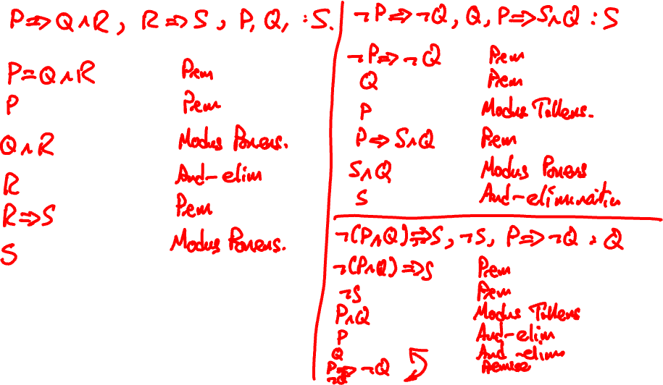

Slide 65
Day 1 Wrap-up
Relationship between Logic and Reasoning
Propositional Logic – sentences that are True of False
Formalisation of Propositional Logic
Knowledge Bases
Natural Deduction
Tomorrow:
Automated Reasoning
Rule-based Systems
Proof and Search

Slide 66
MSc Artificial Intelligence
Knowledge Engineering
Week 1: Logic
Notes:
This colour bar is to be used for Artificial Intelligence

Slide 67
Recap from Day 1
On day 1 we learned:
To represent and reason about knowledge using Logic
The principles of Propositional Logic
Proving argument correctness
On day 2 we will:
Learn how to use an automated tool for natural deduction

Slide 68
Automated Reasoning with Kanren
Open the Kanren Tutorial Notebook and code along…

Slide 69
Exercises: Kanren

